Slide 1
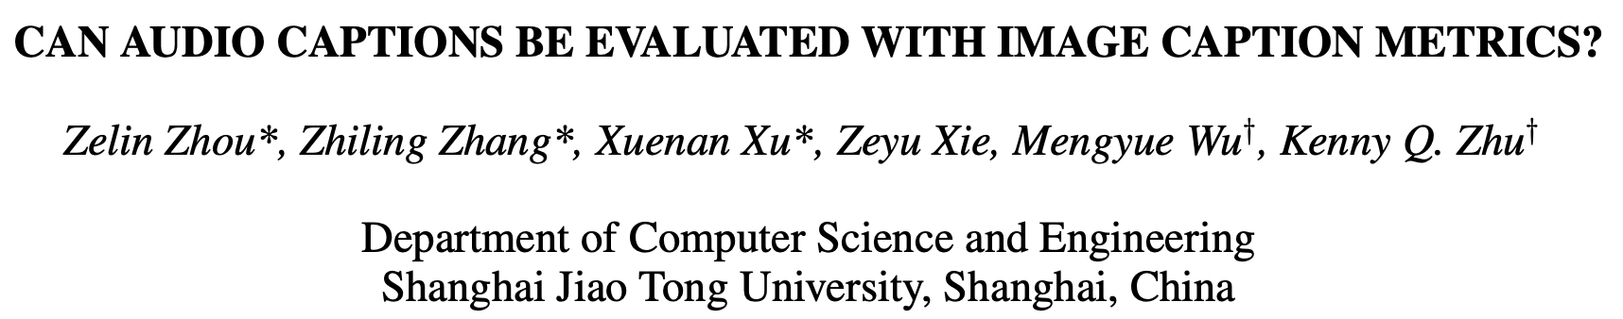
Notes:
Hello everyone, I‘m zhouzelin. Today I will present my paper with xuxuenan accepted by ICASSP 2022, (Title)

Slide 2
Outline
Introduction
Evaluation metrics
Benchmark Dataset Construction
Experiment results
Notes:
- Here is an outline of this talk
There are mainly four parts,
an introduction of Automated Audio Captioning and its evaluation
A quick overview of current evaluation metrics and our proposed metric
The benchmark dataset construction process
And experiment results on our annotated datasets

Slide 3
INTRODUCTION
Notes:
First comes to the introduction part

Slide 4


Automated Audio Captioning
Audio Pattern Recognition
Natural Language Generation
Recognize certain pattern in audio
Centralized with sound events
Audio Tagging
Sound Event Detection
Understand and generate the contents of audio with free text
Centralized with Language Models
which predicts the next word
a man speaking as a crowd of ________
start
end
people
cats
dogs
···
Laughter
Man Speaking
Applause
Sampling from vocabulary
Notes:
Automated Audio Captioning is a cross-modal task involving both Audio Pattern Recognition and Natural Language Generation
Audio pattern recognition aims at (Click) (Read)
(Click) it is (Read), for example Audio Tagging or Sound Event Detection
(Click) Given an audio clip, Audio pattern recognition systems need to extract certain events within the clip, such as (Read)
On the other hand, (Click) the natural language generation part of an automated audio captioning system should (Read)
(Click)It is centralized with autoregressive Language Models, which predicts the next word of a given sentence
(Click)For example, given the incomplete sentence (Read), the language model should sample from the vocabulary to fill in the next blank
(Click)Automated Audio Captioning is a task bridging Audio Pattern Recognition and Natural Language Generation

Slide 5


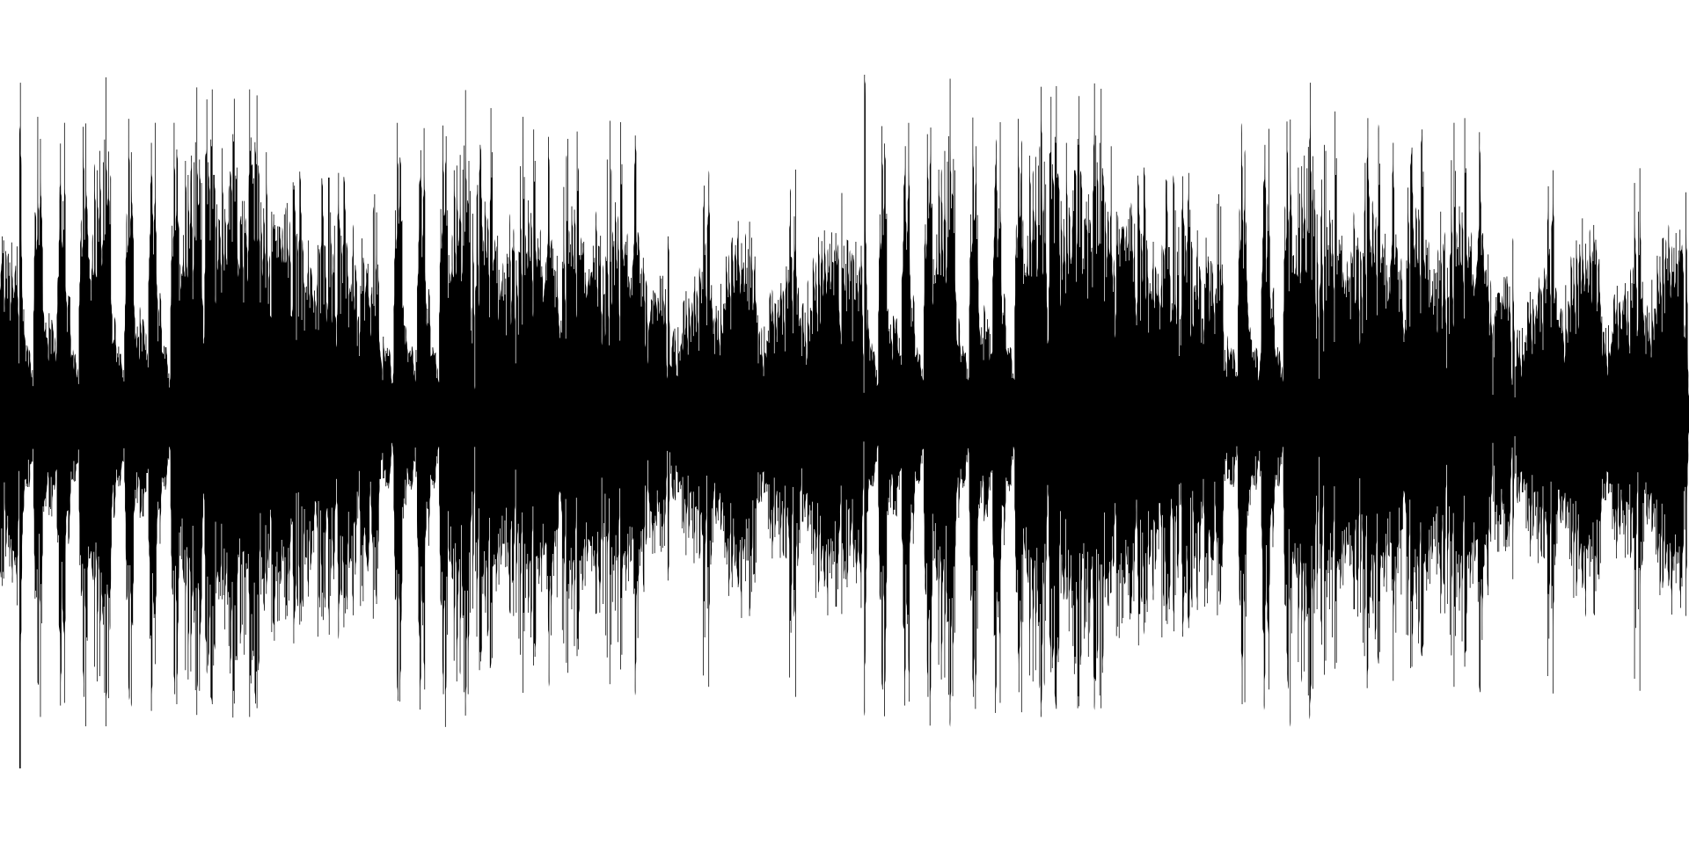
Different Captioning Tasks
Image Captioning
A women in blue blouse sits at a table, with crinkled paper in her hand
Visible attributes & Spatial relationships
Focus:
Audio Captioning
Young women speaking with crinkling noise
Auditory properties & Temporal connections
Notes:
We may associate this task with its counterpart in visual domain, called image captioning
(Click)While an image is given, the image captioning system would say (Click)(Read)
However, accompanied with this audio clip (Click play), and audio captioning system would say (Click)(Read)
From this example, we can distinguish the different focus of two tasks(Click)
While image captioning focuses on visible attributes of objects and their spatial relationships
Audio captioning puts more attention on auditory properties of events and their temporal connections

Slide 6
Caption Evaluation
We usually evaluate machine generated captions based on human written reference texts
Current evaluations for audio caption directly adopt the metrics from the image captioning literature
BLEU
ROUGE
METEOR
CIDEr
SPICE
From NLG Evaluation
Specifically for image captioning
Notes:
When the captions are generated, how do we evaluate its quality?
(Click)The answer is that(Read)
In other words, we evaluate the quality of machine generated sentences by calculating how similar they are with human written ones
(Click)(Read)
However, (Click),the first three metrics are from traditional Natural Language Generation tasks, based on N-gram exact matches
(Click)the latter two metrics are specifically designed for image captioning
A natural question is, are they suitable for the newly proposed audio captioning task?

Slide 7
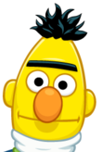

Caption Evaluation
Reference: Paper crackling with female speaking lightly in the background
Caption A: Young woman speaking with crinkling noise
✅
Caption B: Wind blowing lightly followed by a female speaking
Caption C: Wind blowing lightly followed by a female speaking and in the
Metric | A | B | C
BLEU_1 | 0.10 | 0.33 | 0.45
ROUGE_L | 0.12 | 0.23 | 0.40
CIDEr | 0.11 | 0.41 | 0.64
SPICE | 0 | 0.44 | 0.44
Sentence-BERT | 0.78 | 0.62 | 0.62
Notes:
Our answer is No. Here is an example.
We use the previous audio clip still, the reference text is (Click)(Read)
We have three machine generated captions with respect to this clip
Caption A says, (Click)(Read)
Caption B says, (Click)(Read)
While Caption C says, (Click)(Read)which is an incomplete sentence generated by machine
(Click)For our human, it’s quite easy to tell that Caption A is much better than the other two captions, since it precisely paraphrases reference without any grammar error
(Click)However, in this table, most current metrics favor Caption C except for our newly repurposed Sentence-BERT, in that Caption C has most words in common with reference
Which means it remains a challenge for those metrics to tell the semantic differences between sentences
and check the grammar errors as well
Moreover, SPICE even leaves a zero score on the correct Caption A, the reason behind it is worth thinking

Slide 8
SPICE Metric
SPICE
Scene graph overlap between two sentences
🤔Can Audio Captions Be Evaluated with Image Caption Metrics?
Example: A young girl standing on top of a tennis court
girl
tennis court
on top of
Reference: Paper crackling with female speaking lightly in the background
background
Caption A: Young woman speaking with crinkling noise
woman
crinkling noise
with
Notes:
When we go deeper into SPICE metric, we could know that it is calculated based on scene graph overlap between two sentences
(Click)Take an example from its original paper, the sentence (Read) would be parsed into such a scene graph
girl on top of a court. I’ve omitted the modifiers for simplicity
(Click)When we come back to the reference sentence and Caption A,
(Click)we can see the sound events within this sentences could not be properly parsed,
which leads to their poor correlation result
(Click)Therefore, we raise the question as the title of this paper, (Read)

Slide 9
EVALUATION METRICS
Notes:
Here are other metrics we’d like to compare with

Slide 10
Automatic Evaluation Metrics
Traditional NLG Metrics
BLEU
ROUGE
METEOR
Image Caption Metrics
CIDEr
SPICE
Pre-trained Model Based Metrics
BERTScore
BLEURT
N-gram overlap based metrics
Semantic relatedness? 🙁️
Vision centric metrics
Temporal connections? 🙁️
Fluency issues? 🙁️
Notes:
(Click)BLEU,ROUGE,METEOR are traditional natural language generation metrics based on N-gram overlap calculation
(Click)These metrics may fail to capture semantic similarity beyond exact word match
(Click)CIDEr and SPICE are image caption metrics centralized with visual information,
(Click)they might not catch the temporal connections in audio captions
(Click)Recently, Pre-trained Model Based Metrics emerged in NLG tasks and achieves great success,
(Click)However, all the above metrics are unable to tackle fluency issues in audio captioning like grammar error or incomplete sentences

Slide 11
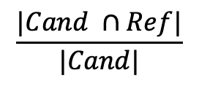
BLEU
$$\frac{|Cand ∩Ref|}{|Cand|}$$
N-gram precision
Quiz 1: BLEU-1 score
Reference: A cat sat on the mat
Candidate 1: A cat is on the mat
Candidate 2: A cat
Candidate 3: the the the the the
➕ Brevity penalty
(to penalize sentences shorter than reference)
➕ Count clip
(to avoid meaningless repetitions)

Slide 12
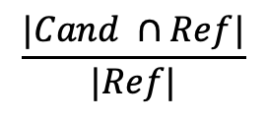
ROUGE
$$\frac{|Cand ∩Ref|}{|Ref|}$$
N-gram recall
ROUGE-N
ROUGE-L
…
Quiz 2: ROUGE-1 score
Reference: A cat sat on the mat
Candidate 1: A cat is on the mat
Candidate 2: A man is on the mat, a cat sat on the man

Slide 13
METEOR & CIDEr & SPICE
BLEU
ROUGE
N-gram exact matches
METEOR
F-measure
WordNet synonyms, Chunks …
CIDEr
TF-IDF similarity calculation
SPICE
Scene graph overlap
N-gram soft matches

Slide 14
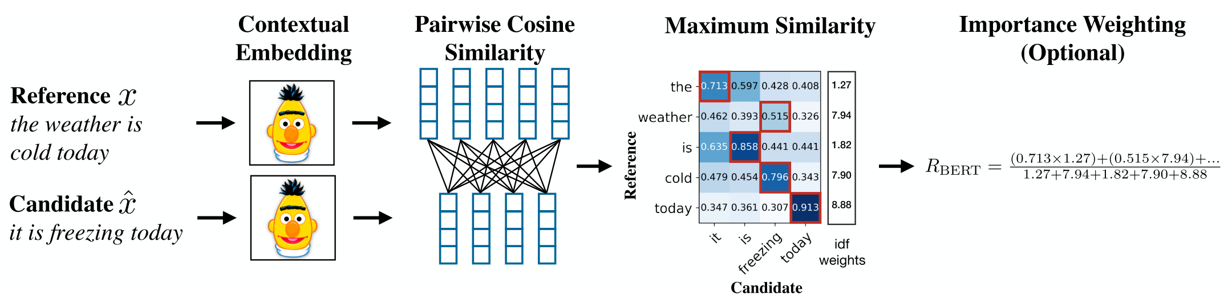
BERTScore

Slide 15
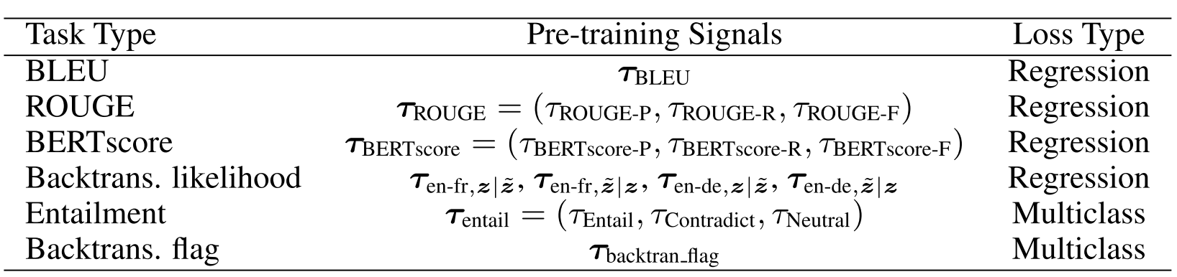
BLEURT
BERTScore
Zero-Shot
Fine-tuning BERT on synthetic dataset
For better estimation of semantic similarity
Using other evaluation metrics as supervision signals

Slide 16
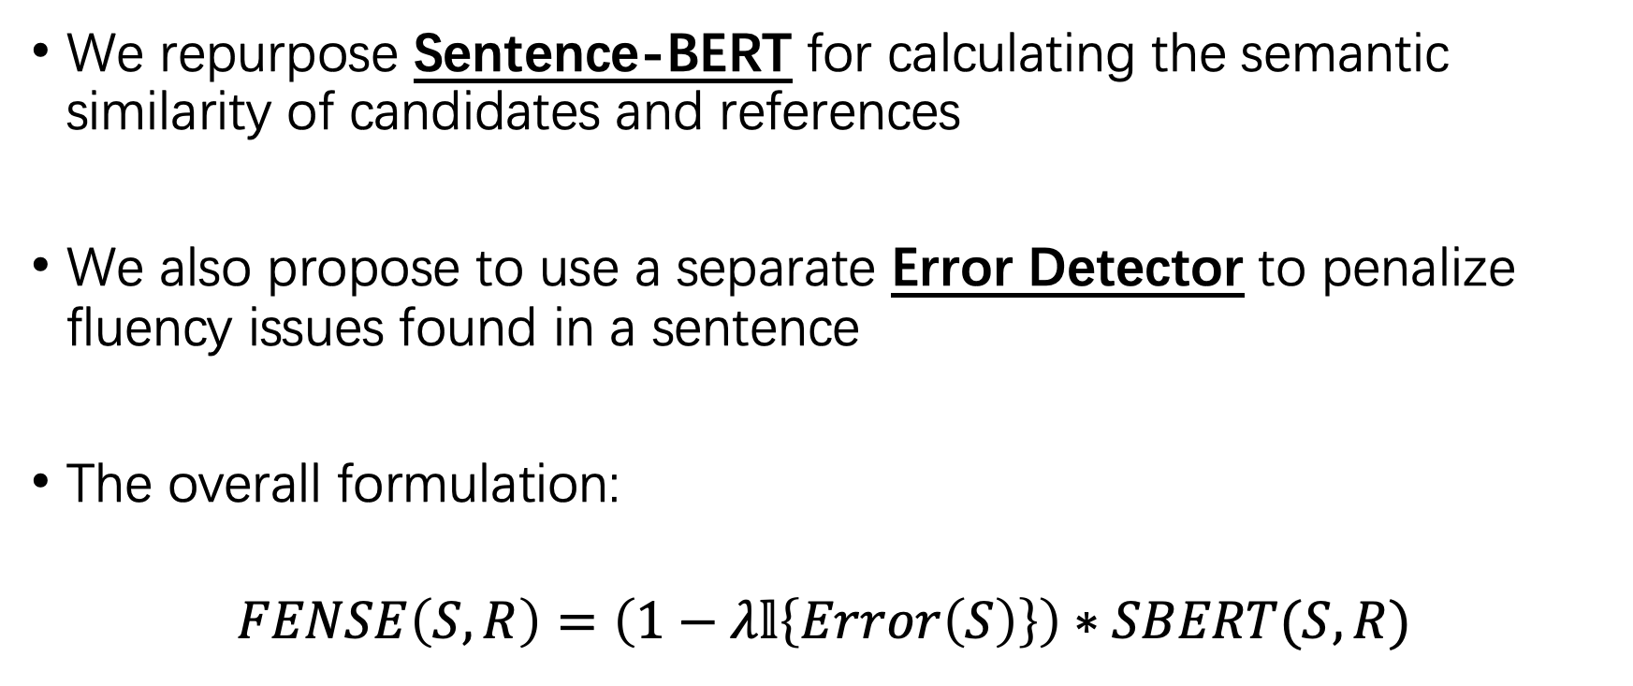
Our Method: FENSE
We repurpose Sentence-BERT for calculating the semantic similarity of candidates and references
We also propose to use a separate Error Detector to penalize fluency issues found in a sentence
The overall formulation:
$$FENSE\left(S,R\right)=\left(1−λ𝕝\left\{Error\left(S\right)\right\}\right)∗SBERT(S, R)$$
Notes:
Thus, (Click)(Read)
(Click)(Read)
In this paper, we set lambda to 0.9

Slide 17
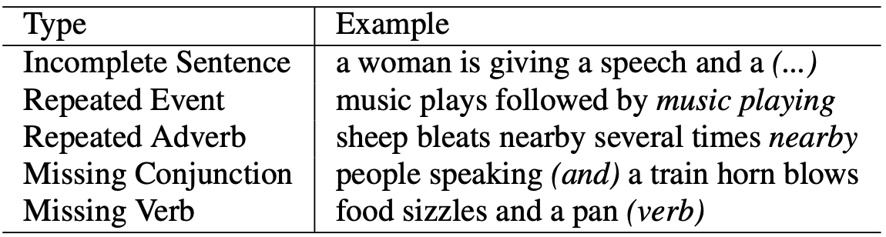
Error Detector
We defined 6 error types and synthesized sentences with fluency issues using heuristics
Then we trained a BERT classifier on the synthesized data
The model achieved a precision of 96.8, recall of 76.4, and F1 of 85.4 on our human annotated test set.
Notes:
For the separate error detector,
(Click)(Read)

Slide 18
BENCHMARK DATASET CONSTRUCTION
Notes:
Next let me introduce how we compare different evaluation metrics

Slide 19
Data resources
Audio and references
AudioCaps
Clotho
Four kinds of pairwise comparison:
HC – Human Correct vs Human Correct
HI – Human Correct vs Human Incorrect
HM – Human Correct vs Machine Generated
MM – Machine Generated vs Machine Generated
Notes:
- (Click)We manually picked some audio clips from AudioCaps and Clotho, which are two of the largest audio captioning datasets.
(Click)Following the paradigm proposed by CIDEr, we’ve done four kinds of pairwise comparison annotations,
(Click)HC means human correct versus human correct, here human correct means the reference sentence for the clip
(Click)HI means human correct versus human incorrect, here human incorrect refers to randomly sampled other clip’s reference sentence
(Click)HM means
(Click)MM means the comparison of two candidates generated by different audio captioning systems

Slide 20
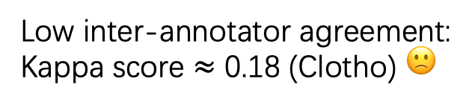
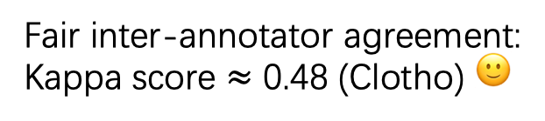
Data Annotation
Protocol 1:
Absolute rating
00:10
Low inter-annotator agreement:
Kappa score $≈$ 0.18 (Clotho) 🙁️
Caption: Young woman speaking with crinkling noise
Your rating: 1 2 3 4 5
Protocol 2:
Pairwise comparison
00:10
Your Choice:
Fair inter-annotator agreement:
Kappa score $≈$ 0.48 (Clotho) 🙂
Caption 1: Young woman speaking with crinkling noise
Caption 2: Wind blowing lightly followed by a female speaking
Notes:
Actually we‘ve experimented two kinds of annotations protocols
- (Click) (Click) (Click)We first ask annotators to give an absolute rating of machine generated sentences after listening to the audio clip
(Click)However, this protocol reached unsatisfying inter-annotator agreement, reflected by fleiss kappa score
(Click) (Click) Then we changed the annotation process.
(Click)after listening to the audio clip, annotators are asked to choose which caption is better
(Click)This protocol reached fair inter-annotator agreement, and was adopted to construct the final benchmark datasets

Slide 21
Data Annotation
Protocol 1:
Absolute rating
00:10
Low inter-annotator agreement:
Kappa score $≈$ 0.18 (Clotho) 🙁️
Caption: Young woman speaking
Your rating: 1 2 3 4 5
Protocol 2:
Pairwise comparison
00:10
Your Choice:
Fair inter-annotator agreement:
Kappa score $≈$ 0.48 (Clotho) 🙂
Caption 1: Young woman speaking
Caption 2: Wind blowing lightly
Notes:
Actually we‘ve experimented two kinds of annotations protocols
- (Click) (Click) (Click)We first ask annotators to give an absolute rating of machine generated sentences after listening to the audio clip
(Click)However, this protocol reached unsatisfying inter-annotator agreement, reflected by fleiss kappa score
(Click) (Click) Then we changed the annotation process.
(Click)after listening to the audio clip, annotators are asked to choose which caption is better
(Click)This protocol reached fair inter-annotator agreement, and was adopted to construct the final benchmark datasets

Slide 22
Audio Captioning Systems
Nearest neighbor (NN) retrieval system
Fully Connected (FC) input system
Attention (ATT) input system
Reinforcement Learning (RL) system
FC, ATT and RL systems are all seq2seq encoder-decoder frameworks. They all use a 10-layer CNN as the encoder and a single-layer GRU as the decoder.
Notes:
- We used four different audio captioning systems to generate candidate captions
- They are(Click)(Read)

Slide 23
EXPERIMENTS
Notes:
Next let me show the experiment results on our annotated datasets

Slide 24
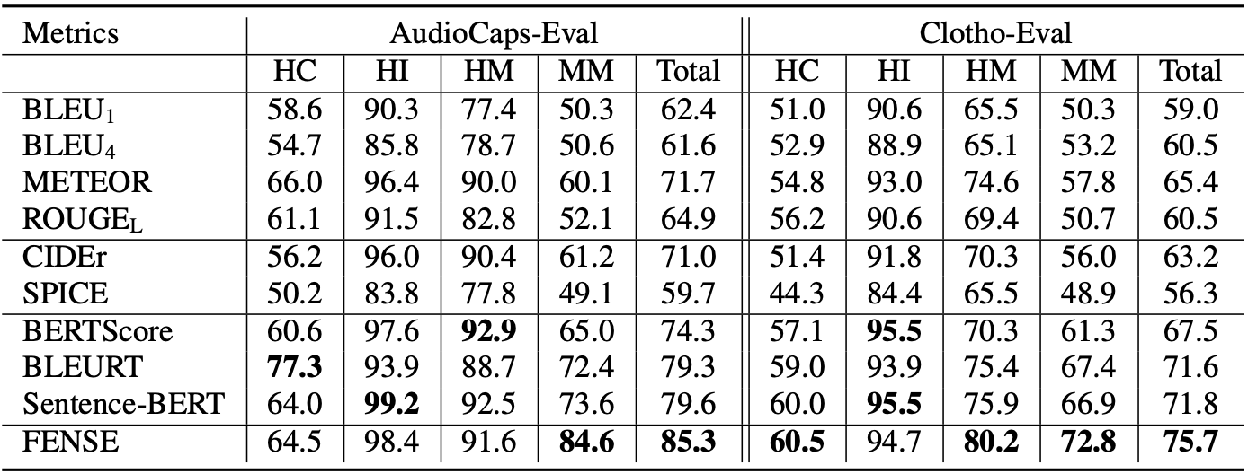
Benchmarking Metrics
Notes:
This table shows the experiment results across different metrics
(Click)We can see that HC and MM poses bigger challenges for all metrics,
and pre-trained model based metrics generally performs better than other metrics
(Click)Note that SPICE performs the worst, even lower than fifty percent,
which strongly confirms our hypothesis that
image captioning specified metrics cannot be adopted in audio caption evaluation
(Click)And our proposed FENSE metric significantly outperforms other metrics on both datasets

Slide 25
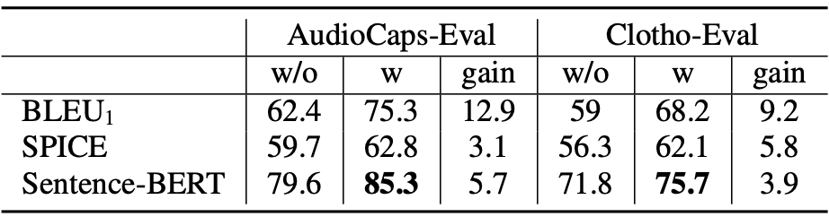
Ablation of Error Detector
Notes:
We‘ve also done ablation tests on the separate Error Detector,
(Click) (Click)With Error Detector, all the three metrics achieve extra performance gain, even for Sentence-BERT
This suggests that
metrics leveraging either N-gram matching or contextual semantic similarity
will fail in detecting fluency issues,
and Error Detector can help mitigate such issues, thus setting a new sota

Slide 26
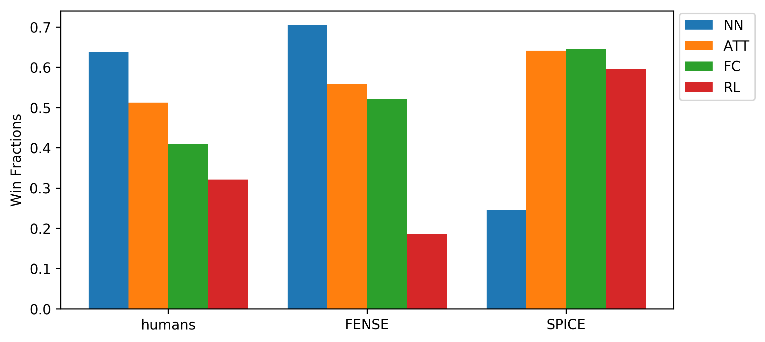
Human & Machine Judgement Illustration
Notes:
Finally we do a comparison of four different audio captioning systems over two evaluation metrics
the y-axis shows the win fractions of 4 audio captioning systems
we can see, Humans and FENSE ranked ATT, FC and RL accordingly after NN,
however, SPICE fails to reach their consensus
This indicates the superiority of FENSE, and further confirms our claim that
image captioning specified metrics like SPICE
are inappropriate to be transferred into audio caption evaluation.

Slide 27
CONCLUSION
Notes:
The conclusion is

Slide 28
Conclusion
In this work,
The first two human judgment datasets for audio caption evaluation, AudioCaps-Eval and Clotho-Eval
Commonly used metrics are not performing well on the two benchmark datasets
Repurposed Sentence-BERT for semantic similarity and Error Detector for fluency issues
The metric combining them two, named as FENSE, exhibits significant advantage
Notes:
We established …
We benchmarked commonly used metrics and find their performance unsatisfying
We repurposed sentence-bert for better estimation of semantic similarity and an Error detector handling fluency issues
(Read)

Slide 29
Thanks!

